Slide 1
Adaptive chemistry game
Vivian Vriezekolk
Supervised by George Kachergis Frank Leoné

Slide 2
Video Games
Problem description and relevance (vanuit daar kun je makkelijk door naar wat je precies wilt doen in je scriptie)

Slide 3
Research question
“Will a game teaching chemistry (molecule structure and names) with an adaptive learning algorithm improve learning compared to the same game without an adaptive learning algorithm?”

Slide 4
Important Aspects
Adaptive algorithm Educational aspects
Spacing effect - Immediate feedback
Metamemory - Intrinsic motivation
Social Interactions - Four principles
- Four pillars

Slide 5
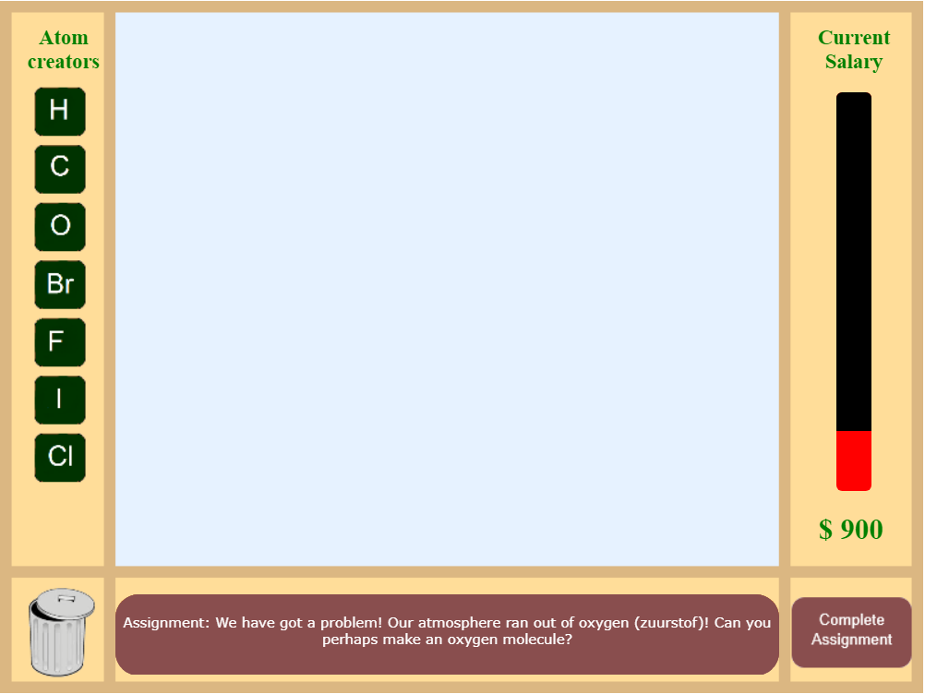
Chemistry game demo
https://chemistrygame-eca18.firebaseapp.com/

Slide 6
Research

Slide 7
Results

Slide 8
Conclusion

Slide 9
Take home message

Slide 10
References

